Slide 1


Presented by Keval Patel
Online Shop
Analytics [2024]
A Path to Growth & Efficiency

Slide 2

Objectives:
Objective: Analyze customer behavior, regional performance, product sales, and transaction trends to uncover actionable insights.
Goal: Drive revenue growth and enhance operational efficiency.
Key Areas of Focus:
Identify top customers.
Determine best-selling products.
Assess high-performing regions.
Evaluate supplier contributions.
Applications:
Optimize marketing strategies.
Improve inventory management.
Enhance customer retention efforts.
Additional Insights:
Analyze order trends.
Review payment statuses.
Calculate customer lifetime value (LTV).
Outcome: Provide a comprehensive understanding of business performance to enable data-driven decision-making.

Slide 3

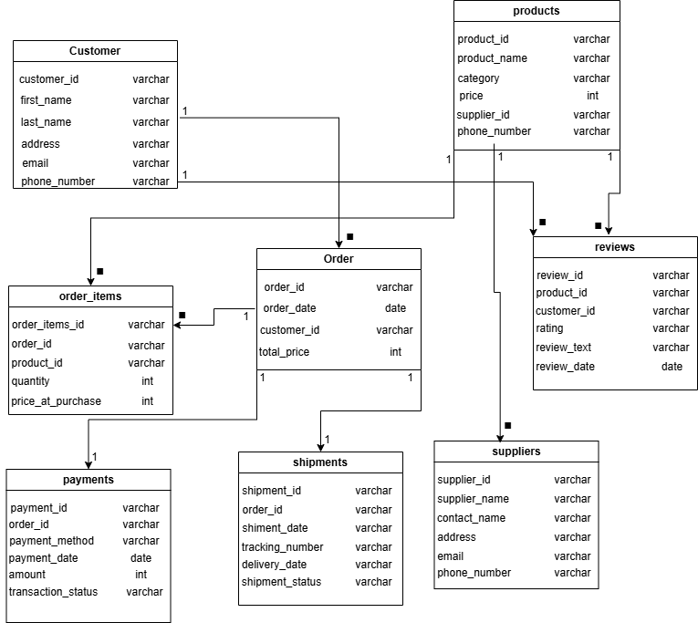


Dataset Overview

Slide 4



Customer Insights
Who are the the Top 10 customers by total spending and what patterns can be observed in their purchasing behaviour?
Retention Analysis for Top Customers.
Top Customers’ Purchase Frequency by Month.
What is the lifetime value (LTV) of a customer?
Customer Cohort Analysis for 2024
2024 Customer Cohort Revenue and LTV Analysis

Slide 5
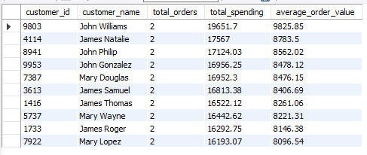
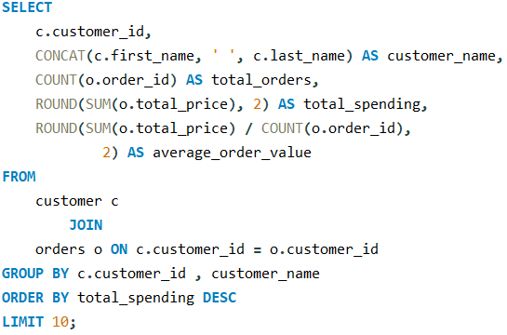
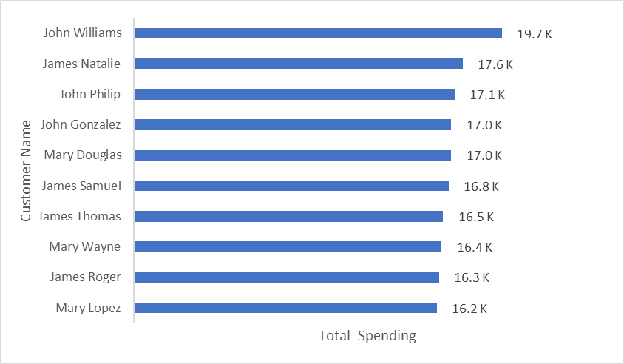
Who are the the Top 10 customers by total spending and what patterns can be observed in their purchasing behaviour?

Slide 6
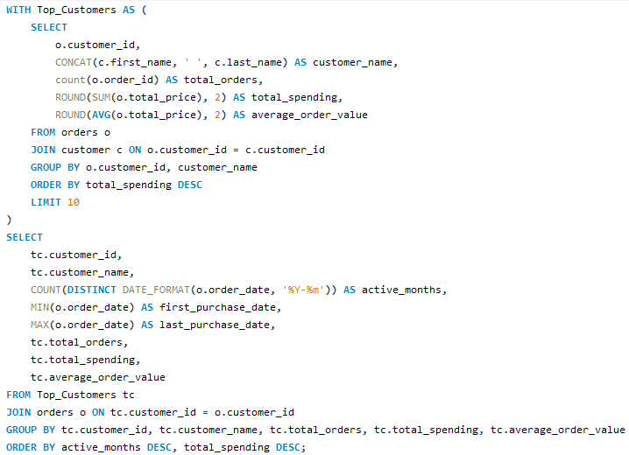
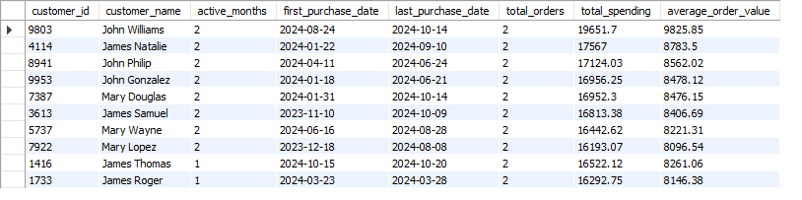
2. Retention Analysis for Top Customers.

Slide 7
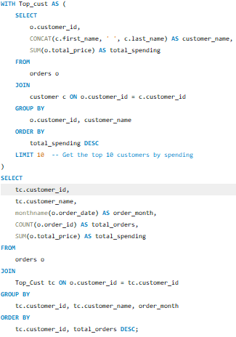
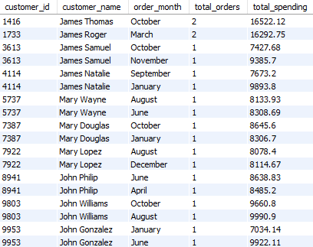
3. Top Customers’ Purchase Frequency by Month.

Slide 8
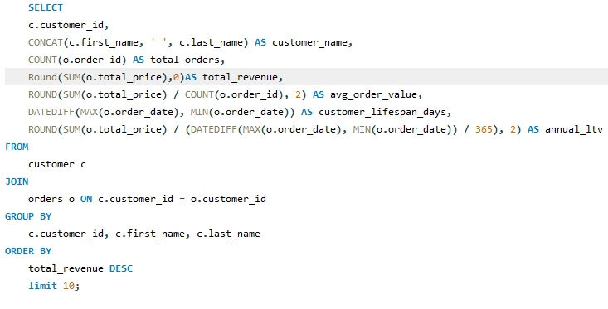
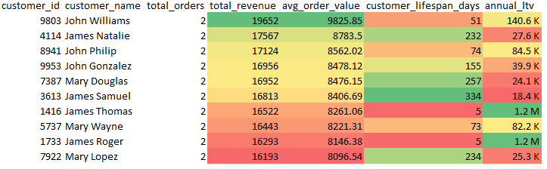
4. What is the lifetime value (LTV) of a customer?

Slide 9
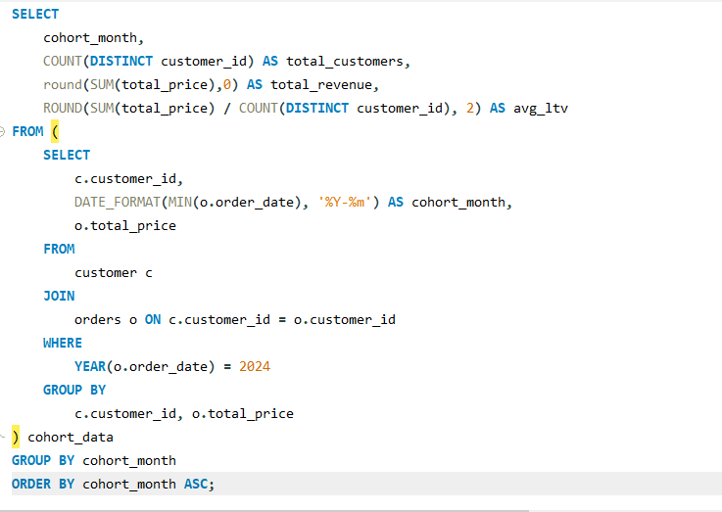
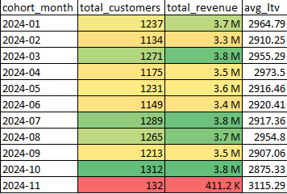
Customer Cohort Analysis for 2024

Slide 10
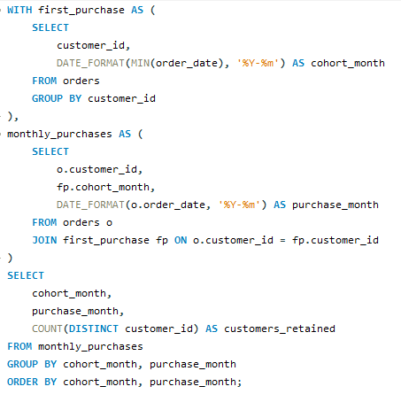
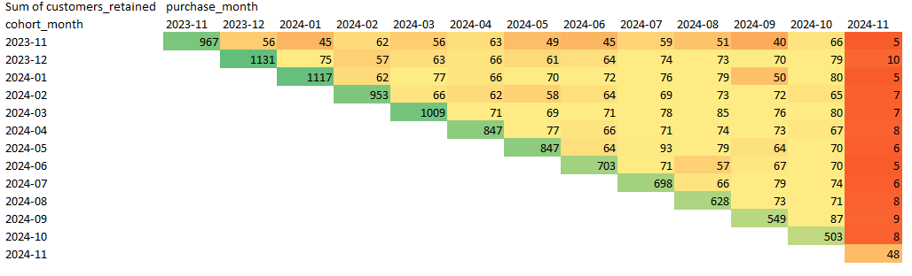
2024 Customer Cohort Revenue and LTV Analysis"

Slide 11
Product Insights
What are the top 10 best-selling products, and how do their sales vary by category?
"Relationship Between Product Ratings and Sales Volume"
Revenue contribution by product category with percentage

Slide 12
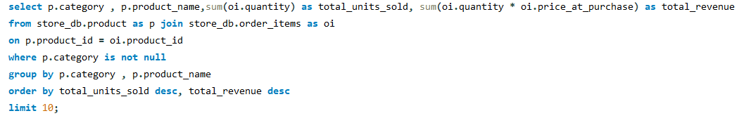
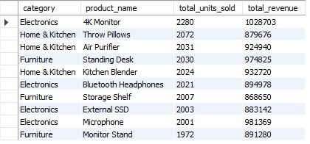
1 What are the top 10 best-selling products, and how do their sales vary by category?

Slide 13
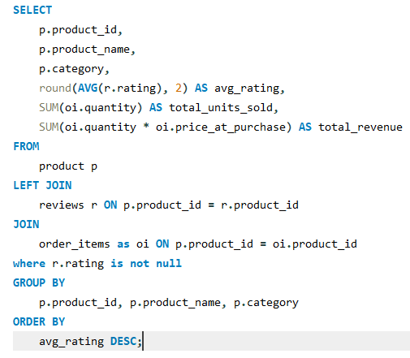
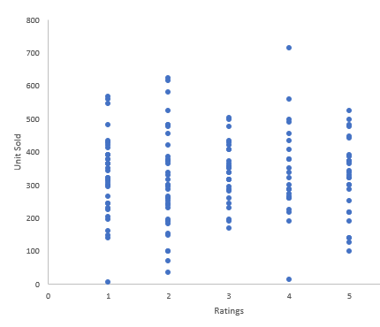
2 "Relationship Between Product Ratings and Sales Volume"

Slide 14
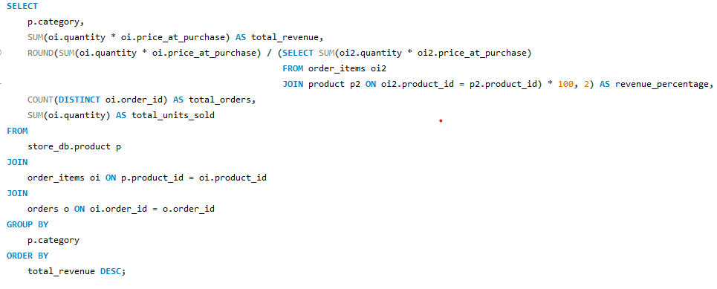
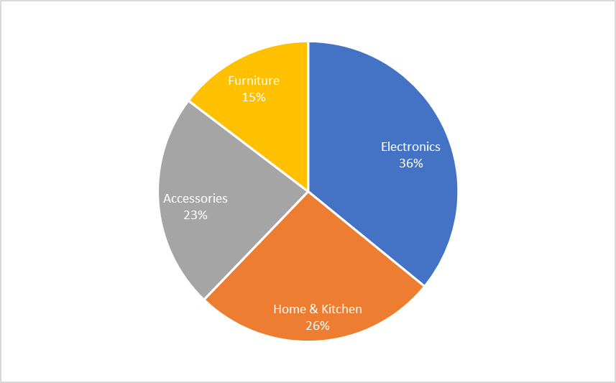
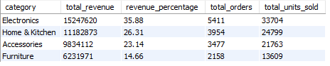
3. Revenue contribution by product category with percentage?

Slide 15
Supliers Insights
Which top 10 suppliers provide the most revenue-generating products

Slide 16
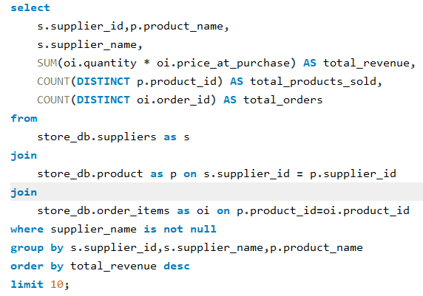
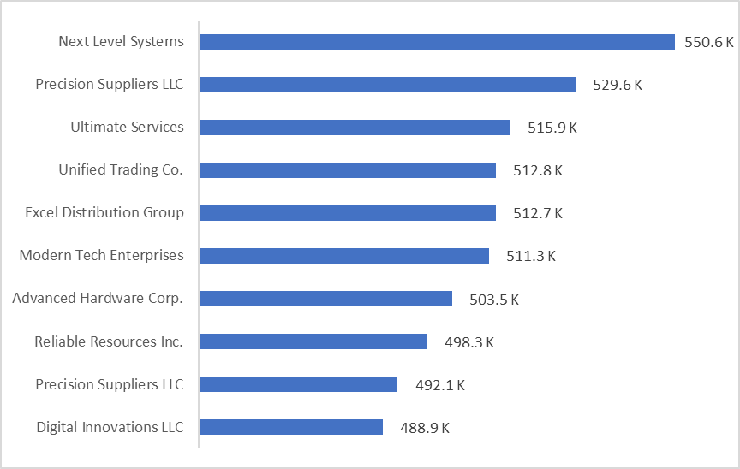
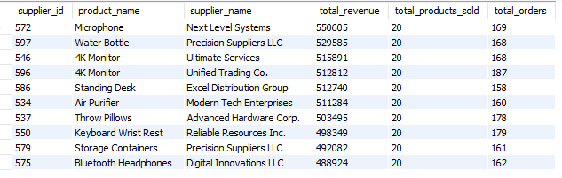
Which top 10 suppliers provide the most revenue-generating products.

Slide 17
Timely Trends
Monthly total orders and total revenue Trends.
Quarterly total orders and total revenue Trends.
Yearly total orders and total revenue Trends.

Slide 18
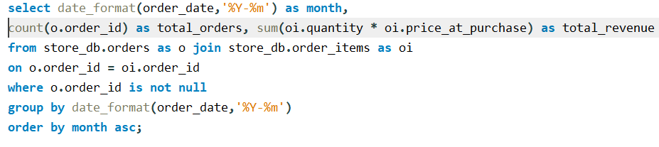
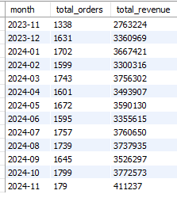
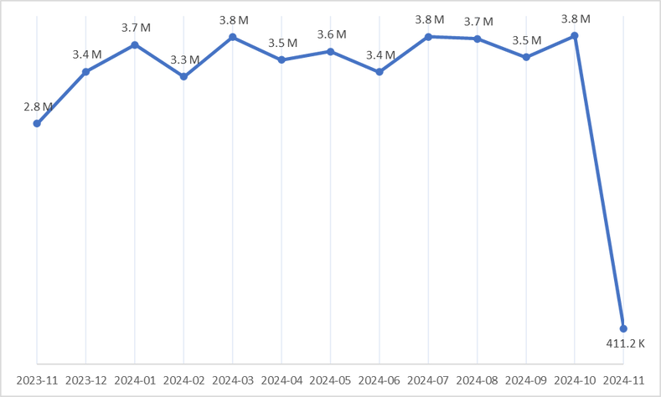
Monthly total orders and total revenue Trends.

Slide 19
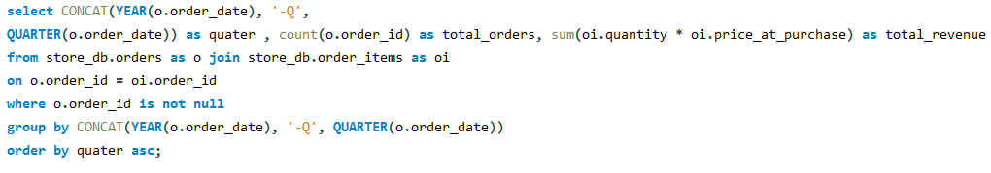
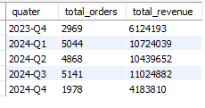
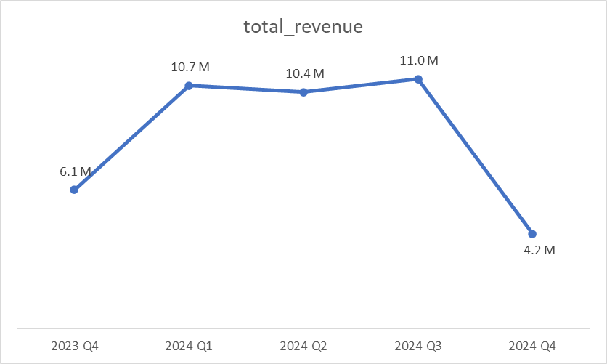
2. Quarterly total orders and total revenue Trends.

Slide 20
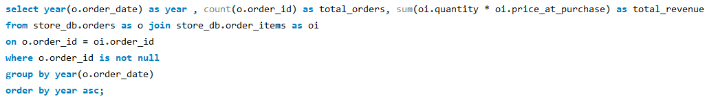
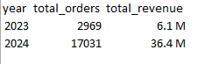
3. Yearly total orders and total revenue Trends.

Slide 21
Regional Research
Top 5 state and city revenue generating.

Slide 22
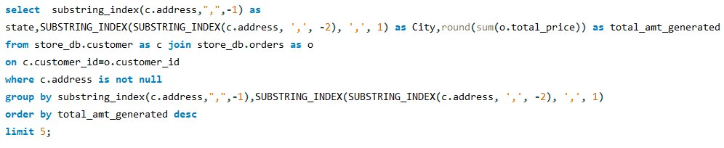
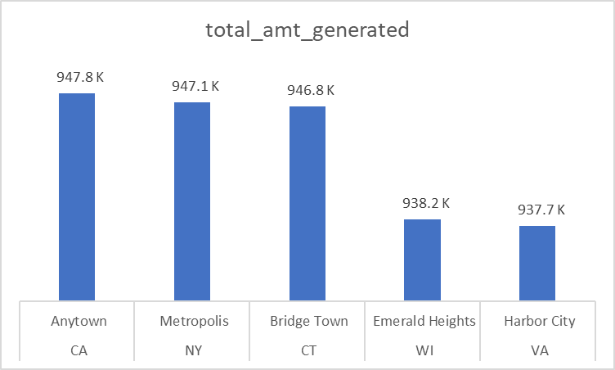
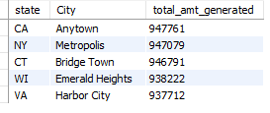
Top 5 state and city revenue generating.

Slide 23
Payment research
How many transaction Completed, Failed, Pending.

Slide 24
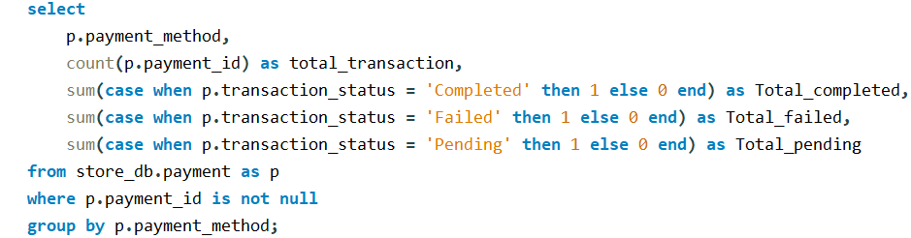
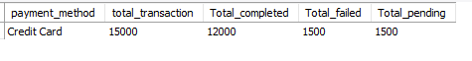
How many transaction Completed, Failed, Pending.

Slide 25


